Slide 1

Fundamentals of Ecology
Week 5, Ecology Lecture 1
Cara Brook
February 4, 2025

Slide 2
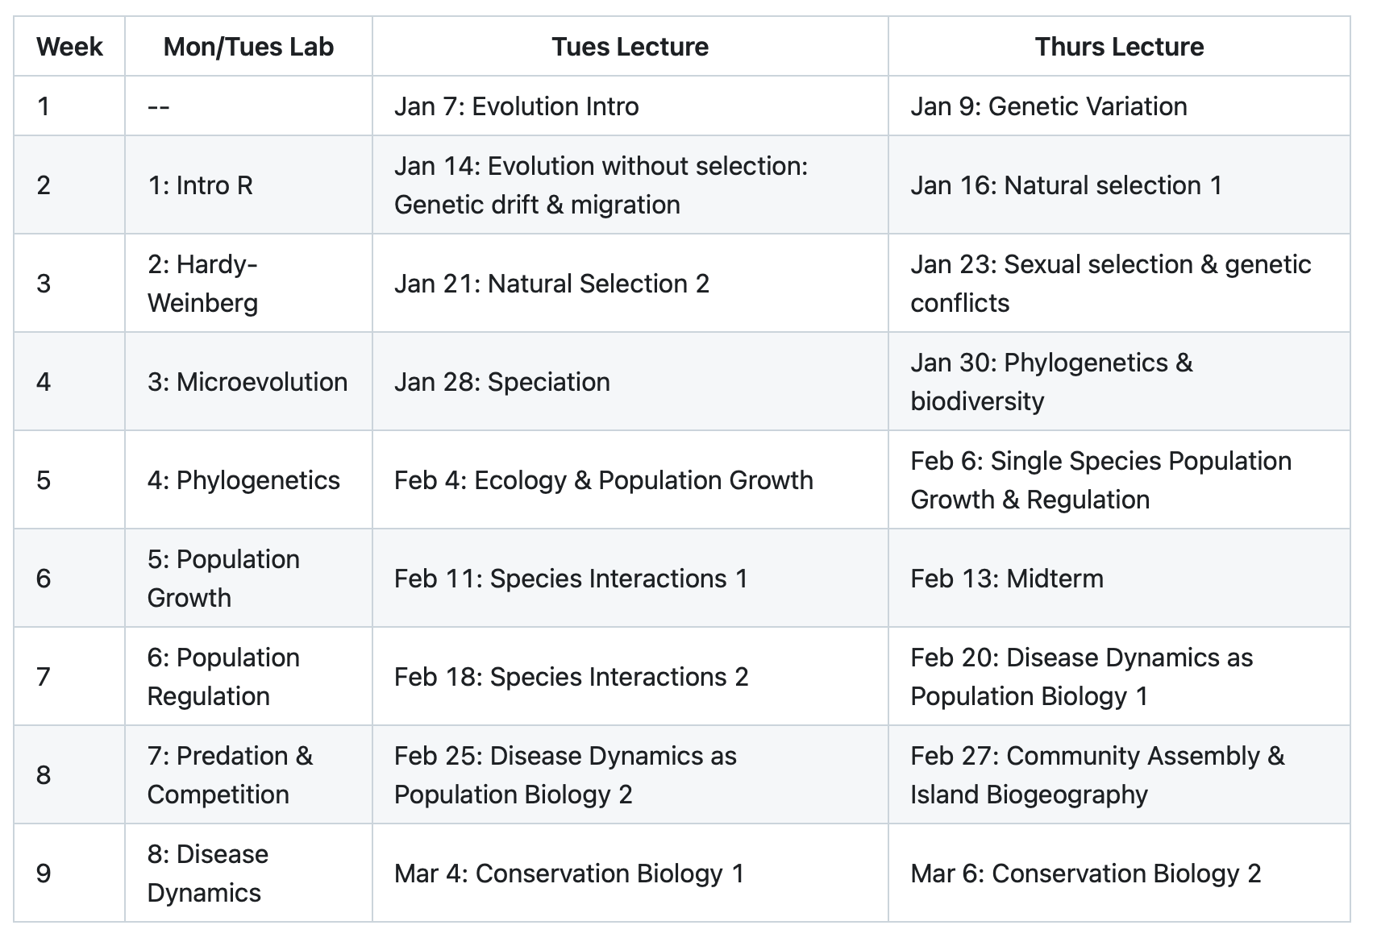
Where are we headed?

Slide 3
Where are we headed?

Slide 4
Where are we headed?

Slide 5
Where are we headed?

Slide 6
Where are we headed?

Slide 7
Where are we headed?

Slide 8
Natural history is the observational study of the living things on planet Earth.
Notes:
-Natural history dates back to antiquity, when in AD 77
- Roman philosopher Pliny the Elder published a sort of encyclopedia on the same name, which covered astronomy, geography, human tech, and medicine, as well as observational study of plants, animals, and fungi--what we think of as natural history today.
-Eventually, natural history gave way to the natural sciences when those observational studies became systematic and were used to to support general laws and principles describing the natural world.

Slide 9
Is natural history science?

Slide 10
Is natural history science?
Science: the systematic observation of natural events and conditions in order to discover facts about them and to formulate laws and principles based on these facts.
– Academic Press Dictionary of Science & Technology

Slide 11
Natural history gave way to the natural sciences when those observations became systematic and were used to support general laws and principles describing the natural world.
Notes:
-Natural history dates back to antiquity, when in AD 77
- Roman philosopher Pliny the Elder published a sort of encyclopedia on the same name, which covered astronomy, geography, human tech, and medicine, as well as observational study of plants, animals, and fungi--what we think of as natural history today.
-Eventually, natural history gave way to the natural sciences when those observational studies became systematic and were used to to support general laws and principles describing the natural world.

Slide 12
Ecology is the study of the interactions of organisms with each other and their environment.
Notes:
Earliest ecological thinkings date back to Greek historian Herodotus (d. 425 BC): Basking Nile crocodiles open mouths for sandpipers to get access and pluck our leeches, giving food to the sandpiper and oral hygiene to the crocodile
Aristotle (c. 330 BC) made observations of animal migration and biogeography

Slide 13
Ecology is the study of the interactions of organisms with each other and their environment.
oikos = 'house’
+ logia = ‘study of'
ecology
- 1866 Ernst Haeckel
Notes:
Earliest ecological thinkings date back to Greek historian Herodotus (d. 425 BC): Basking Nile crocodiles open mouths for sandpipers to get access and pluck our leeches, giving food to the sandpiper and oral hygiene to the crocodile
Aristotle (c. 330 BC) made observations of animal migration and biogeography
Coined as a term in 1866 by German zoologist Ernst Haeckel: from the Greek

Slide 14
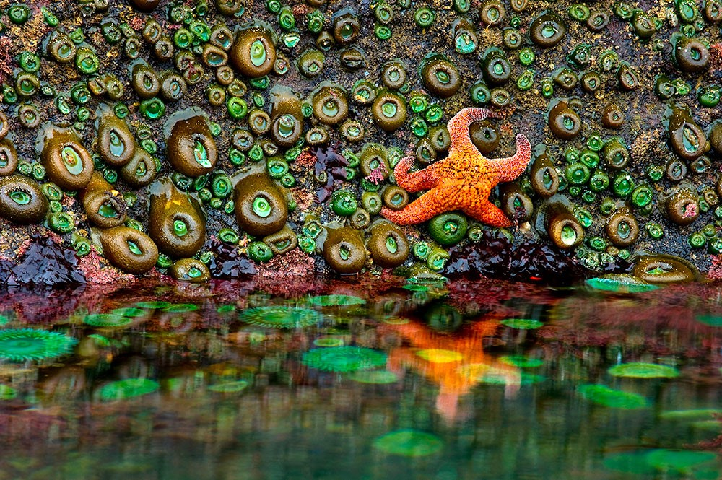
“Ecology has a synonym which is ALL.”
-John Steinbeck
The Log from the Sea of Cortez (1941)
Notes:
In 1941, American author John Steinbeck traveled to the Sea of Cortez, Baja, CA with marine biologist friend Ed Ricketts to characterize the marine invertebrate fauna in the region. Ricketts kept records of his findings and made collections, and Steinbeck wrote a book about the voyage, The Log from the Sea of Cortez, in which he wrote that ‘Ecology has a synonym which is ALL’, in reference to the broad range of interactions capture in this scientific pursuit.
Why do we care about ecology? Because it relates to everything

Slide 15
As a science, ecology uses models to formalize general laws and principles describing the natural world.
Ecology is the study of the interactions of organisms with each other and their environment.

Slide 16
What is a model?
Notes:
an abstract representation of a phenomenon

Slide 17
What is a model?
an abstract representation of a phenomenon
Notes:
an abstract representation of a phenomenon

Slide 18

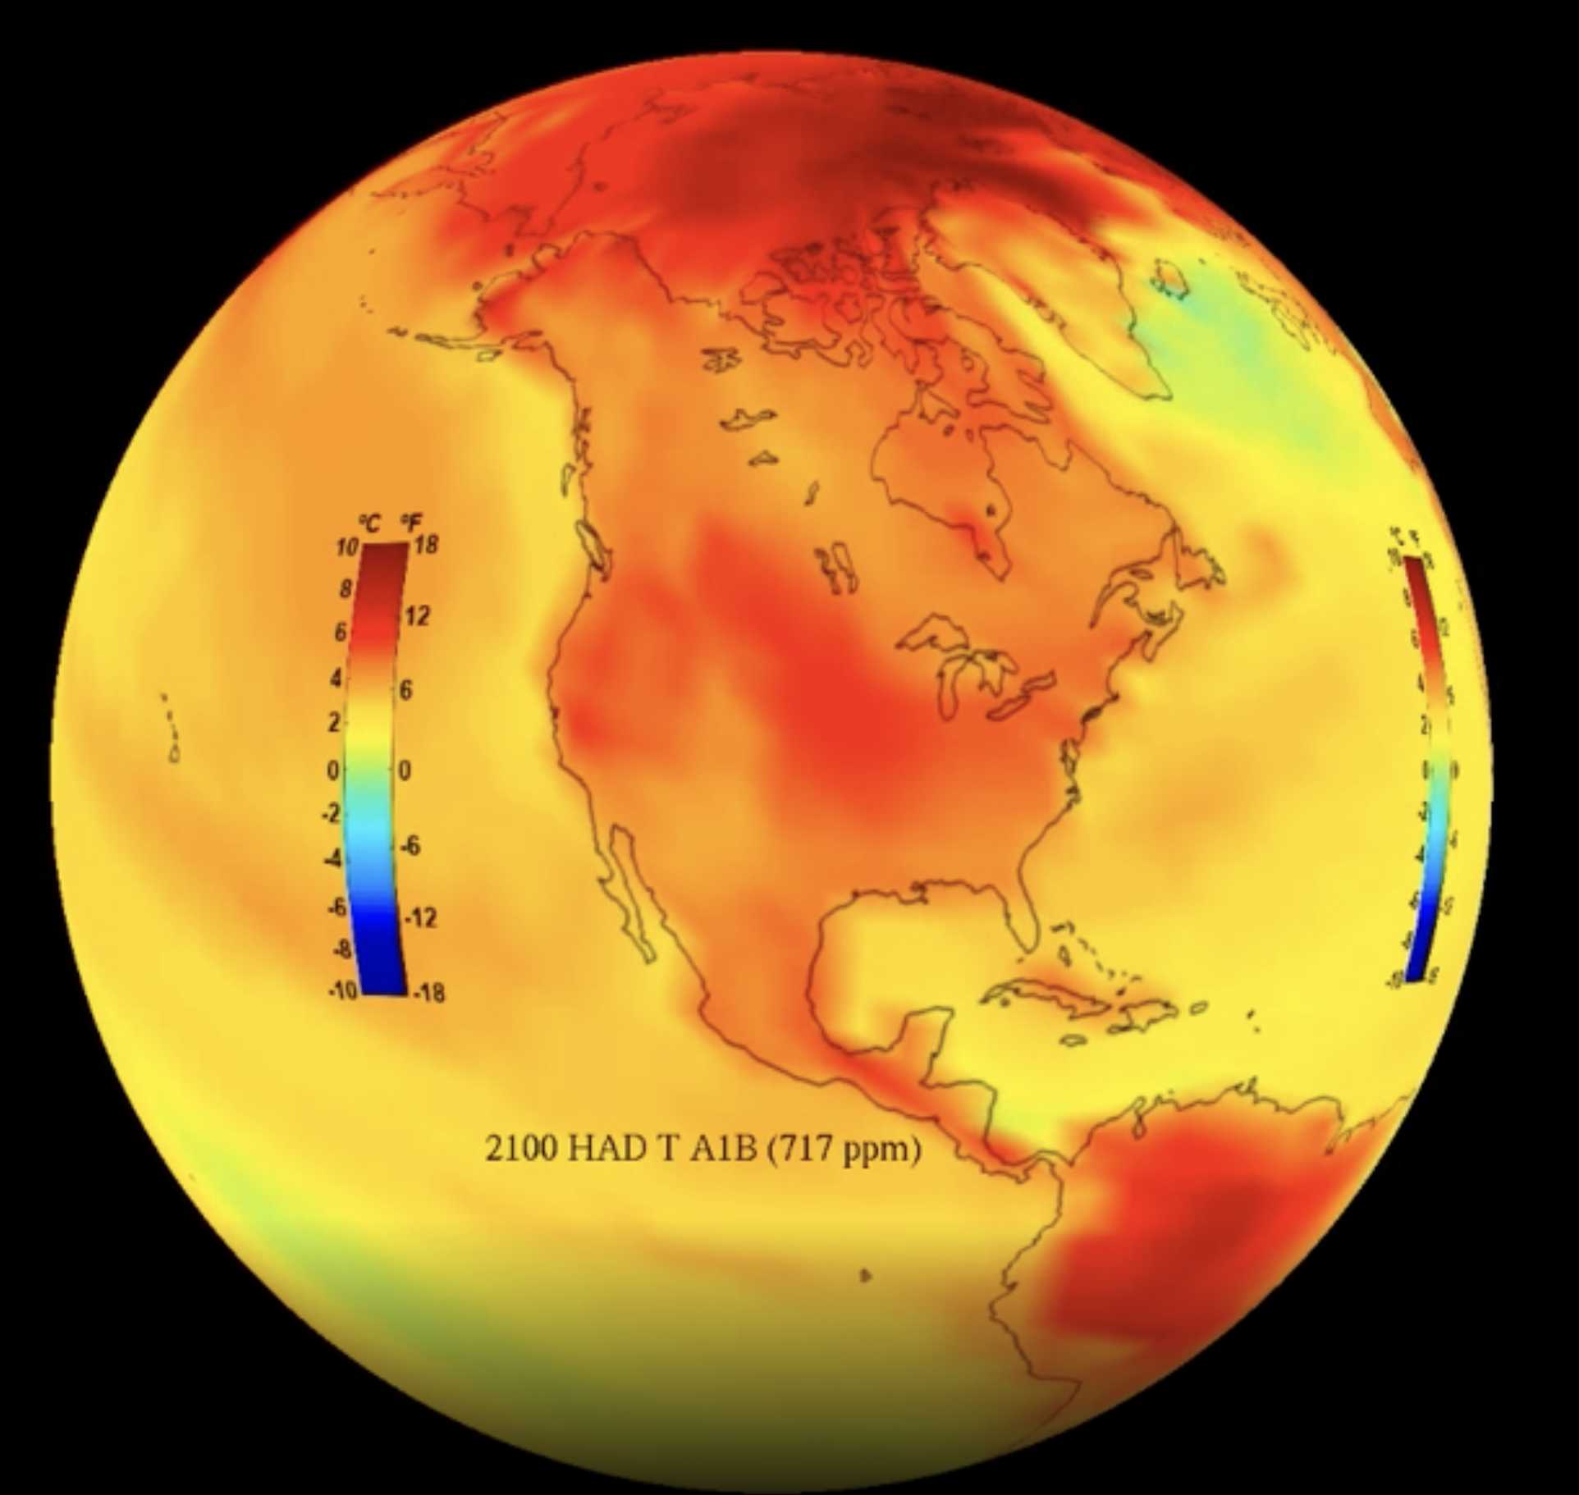

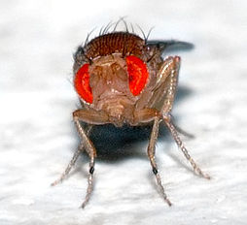
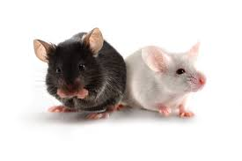
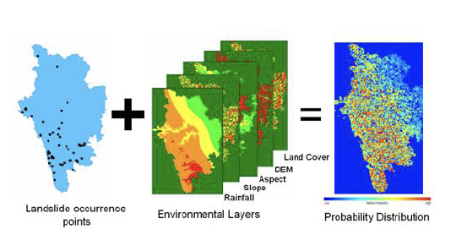
What is a model?
an abstract representation of a phenomenon
Solar System
Climate
Human
Human Genetics
Human Disease
Species Distribution
Notes:
an abstract representation of a phenomenon

Slide 19
Why build models?

Slide 20
Why build models?
to explain and predict

Slide 21
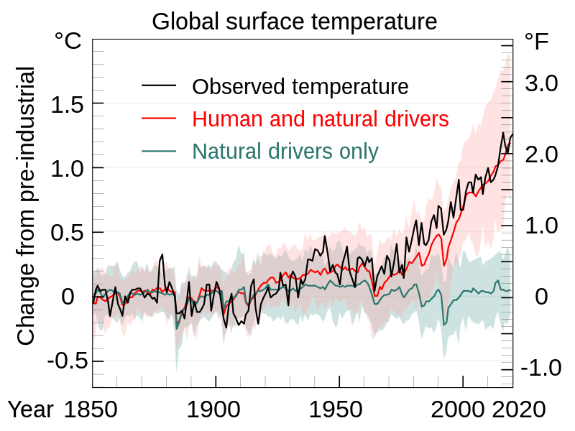
Why build models?
(IPCC 2007)
to explain and predict
Models produce ‘simulated data’ that is compared against the observed data.
The process of adjusting the model to more closely match the data is called ‘model fitting.’
(IPCC)
explain

Slide 22
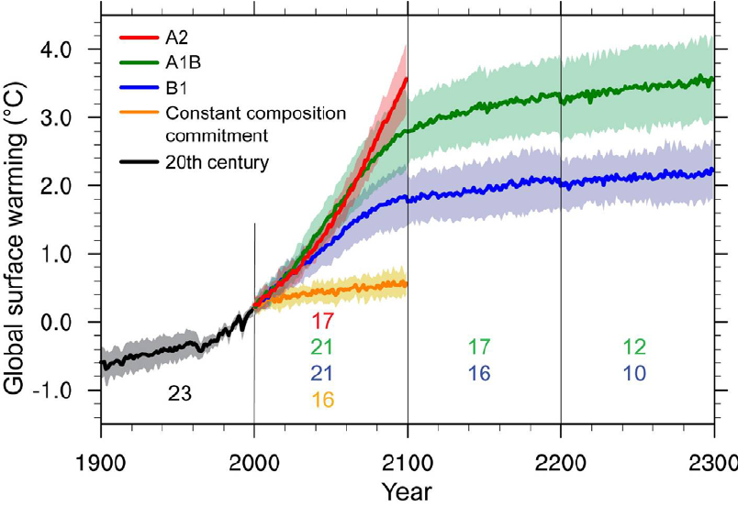
Why build models?
Fitted models can then be used to “predict” the future, under different conditions.
to explain and predict
(IPCC)
explain
predict
(IPCC 2007)

Slide 23
Two kinds of ecological models
Statistical Model
Pattern
Population Model
Process
Notes:
Two kinds of ecological models - both computer models with mathematical equations

Slide 24
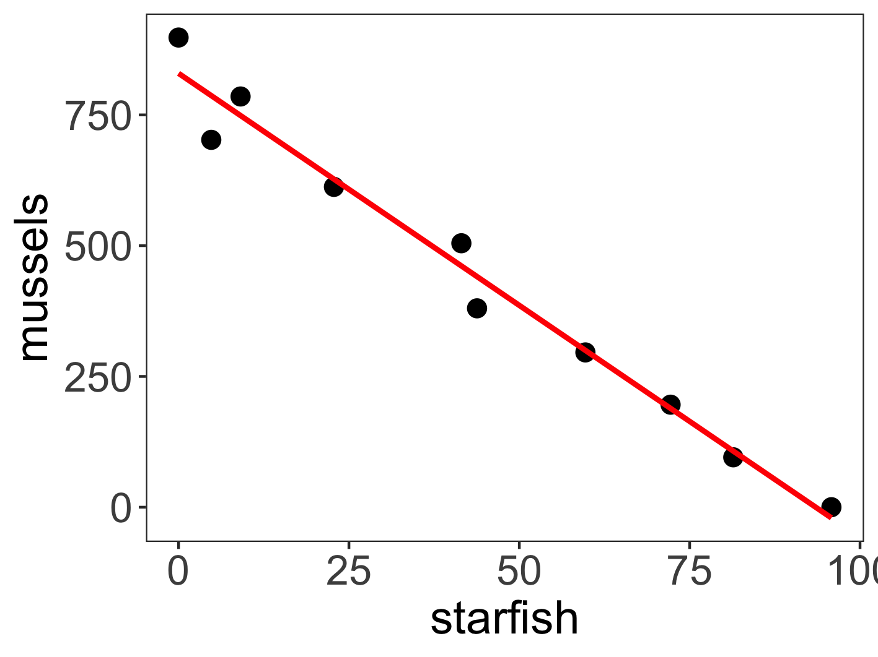
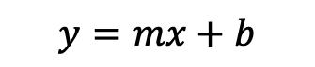
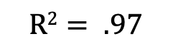
Two kinds of ecological models
Statistical Model
Pattern
Statistical Model
Pattern
What is the relationship between the abundance of starfish and the abundance of mussels?
$$y=mx+b$$
$$R2= .97$$
Population Model
Process
Notes:
Two kinds of models - both computer models with mathematical equations
statistical model, usually trying to decipher patterns in data – like the simple linear regression
What is this model showing? an association between low numbers of starfish and high numbers of mussels
No causation is determined, only correlation

Slide 25
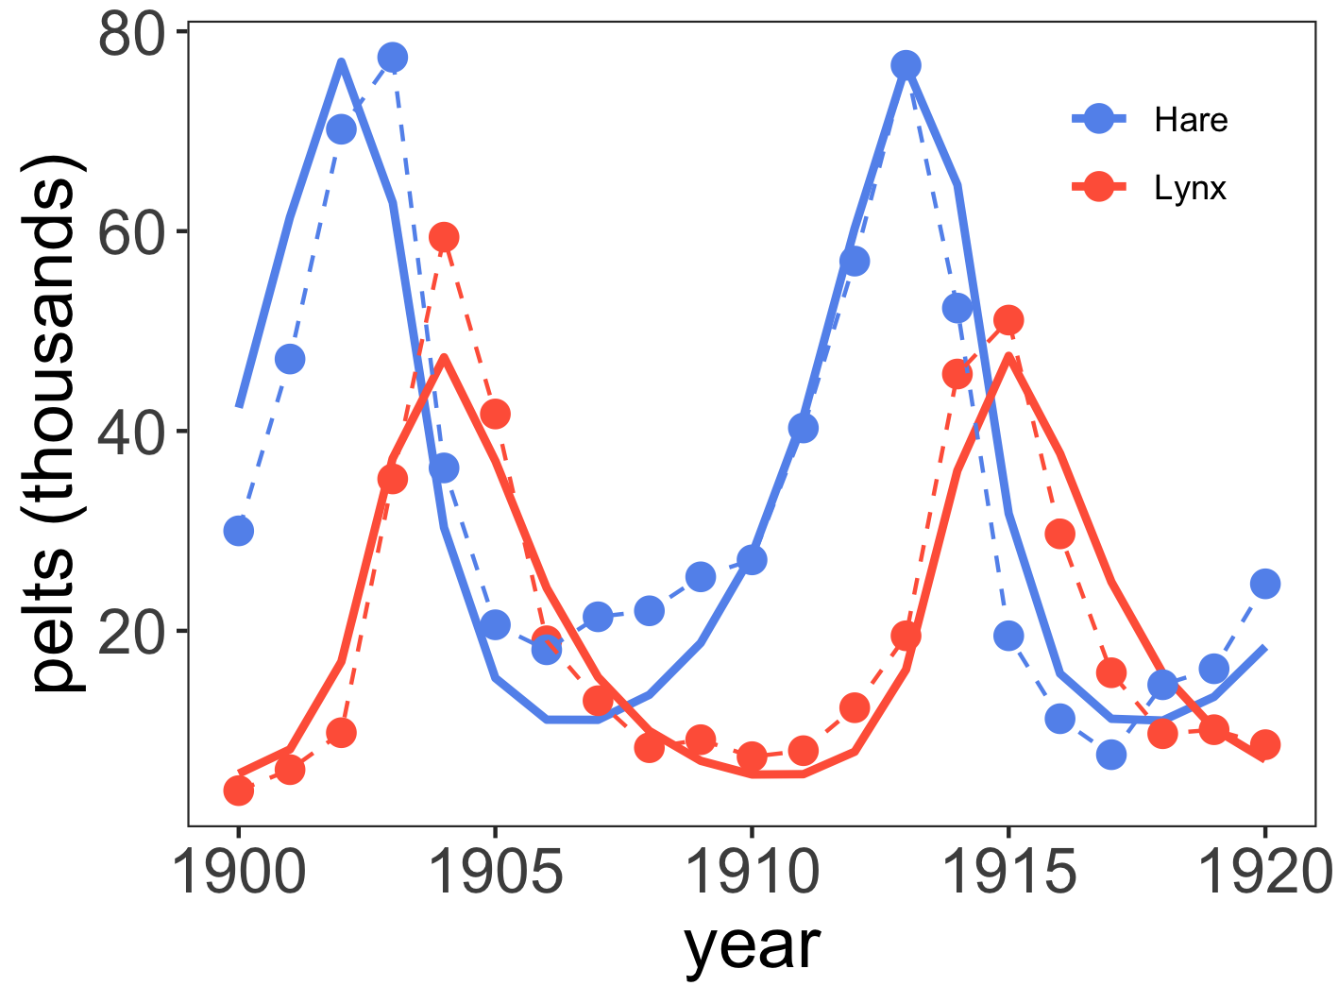
Two kinds of ecological models
Statistical Model
Pattern
mussel
(x)
count
starfish
(y)
mussel
starfish
Population Model
Process
How does the abundance of starfish change as a result of the abundance of mussels?
Notes:
Two kinds of ecological models
statistical model, usually trying to decipher patterns in data – like the simple linear regression
What is this model showing? an association between low numbers of starfish and high numbers of mussels
No causation is determined, only correlation
And the population model (also known as a dynamical model, mechanistic model, compartmental model, mathematical model), tries to describe processes that give rise to data
What processes are shown here?
Mussels are EATEN by starfish… so yes, high numbers of mussels are associated with low numbers of starfish…because starfish predate on mussels
Because this is a dynamic process, we usually use calculus to measure the change in populations through time

Slide 26

How to construct a population model
mussel
(x)
$$boxes=state variables$$
starfish
(y)

Slide 27

How to construct a population model
mussel
(x)
$$state variables$$
$$boxes=state variables$$
starfish
(y)

Slide 28

How to construct a population model
mussel
(x)
$$solid lines=processes$$
starfish
(y)

Slide 29
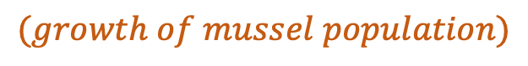
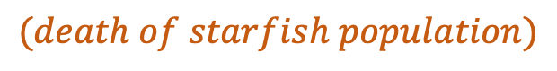
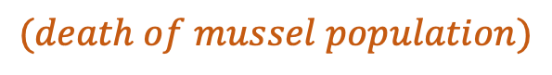
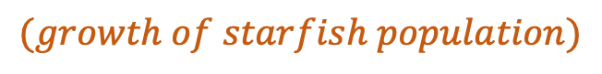
How to construct a population model
$$(growth of mussel population)$$
mussel
(x)
$$(death of mussel population)$$
$$solid lines=processes$$
$$(growth of starfish population)$$
starfish
(y)
$$(death of starfish population)$$

Slide 30

How to construct a population model
mussel
(x)
$$processes$$
$$solid lines=processes$$
starfish
(y)

Slide 31

How to construct a population model
mussel
(x)
starfish
(y)
$$dashed lines=interactions$$

Slide 32
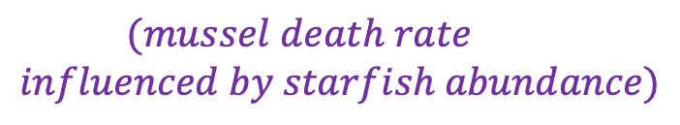

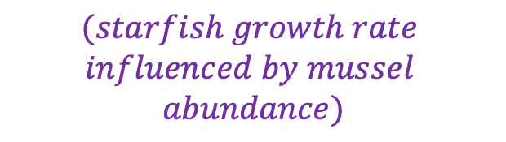
How to construct a population model
mussel
(x)
$$(mussel death rate$$
$$influenced by starfish abundance)$$
$$interactions$$
starfish
(y)
$$(starfish growth rate$$
$$influenced by mussel$$
$$abundance)$$
$$dashed lines=interactions$$

Slide 33


Slide 34
Ecology is the study of the interactions of organisms with each other and their environment.
dynamic
frequently changing
complex
many interacting parties
Notes:
Because we use pop models, we can think of ecology as the study of complex adaptive systems – how organisms interact is dynamics (always changing) and complex – many interacting parties

Slide 35
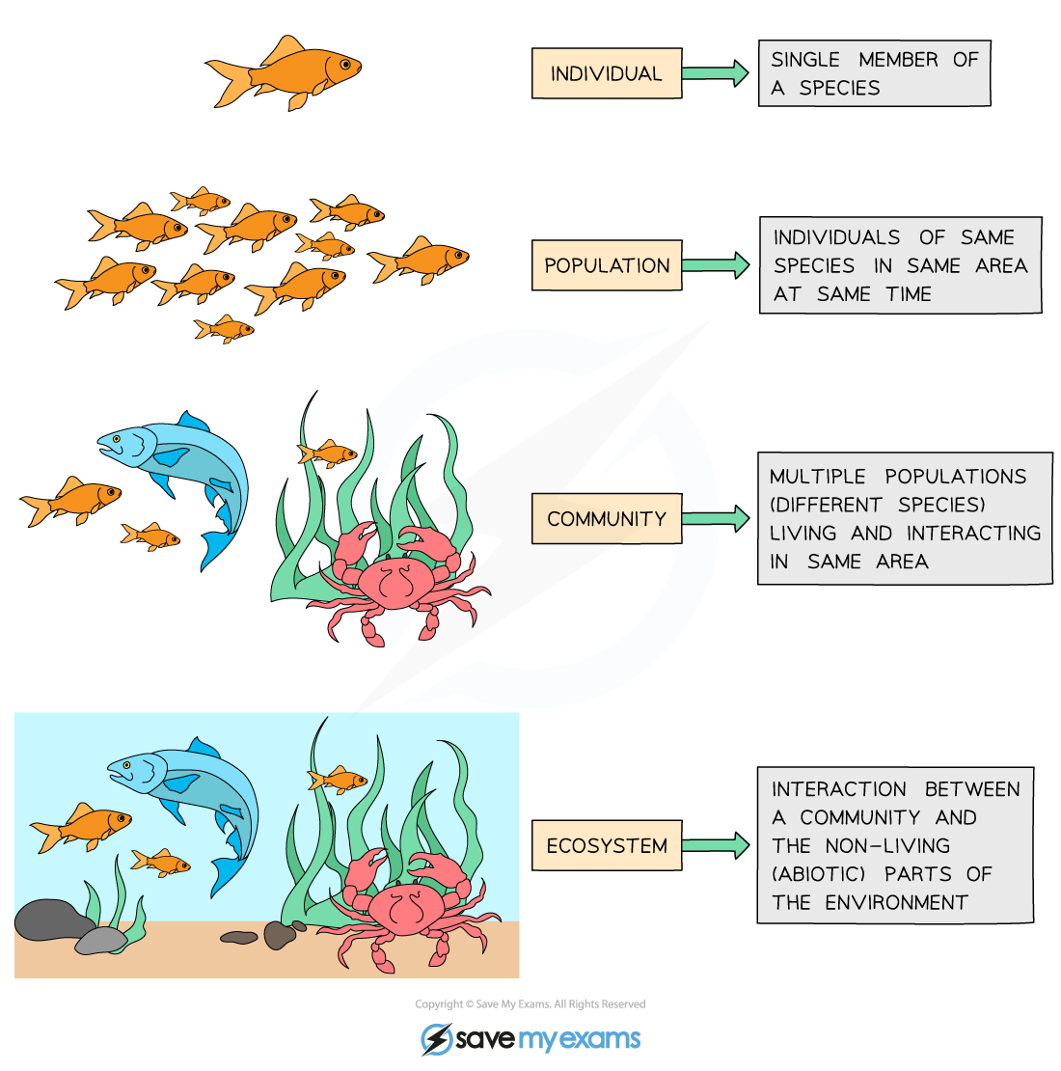
Ecology is the study of the interactions of organisms with each other and their environment.
individual
population
metapopulation
community
ecosystem
Notes:
We explore ecology – using models – across scales

Slide 36
individual
Individual: metabolism, behavior, life history.
interactions of an individual with the environment
population
metapopulation
community
ecosystem
Notes:
At the bottom, there is the level of the individual. Since ecology concerns interactions of organisms with each other and the environment, here we means how an in individual interacts with the environment

Slide 37
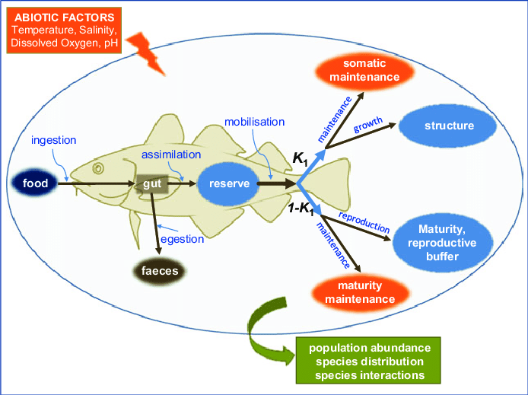
individual
Individual: metabolism, behavior, life history.
Dynamic Energy Budget (DEB) Model
population
metapopulation
How does a fish’s metabolism change with temperature?
community
ecosystem
McKenzie et al 2016. Conservation Physiology
Notes:
Interactions of an individual with the environment

Slide 38
individual
Population = multiple individuals of the same species (conspecifics) in the same habitat
population
metapopulation
community
ecosystem
Notes:
Then, we scale up to the population

Slide 39
individual
Population = multiple individuals of the same species (conspecifics) in the same habitat
population
metapopulation
fish
(x)
community
How does the abundance of fish change through time?
ecosystem

Slide 40
Nested Models, including a class of model known as Integral Projection Models (IPMs), link individual- and population-level processes
individual
population
metapopulation
fish
(x)
community
How does the abundance of fish change through time as temperature changes metabolism?
ecosystem

Slide 41
Metapopulation = sub-populations of conspecifics connected by migration or dispersal
individual
population
metapopulation
community
ecosystem
Notes:
Then to the metapop

Slide 42
Metapopulation = sub-populations of conspecifics connected by migration or dispersal
individual
population
fish₁
(x₁)
metapopulation
fish₂
(x₂)
community
How do the abundances of different subpopulations of the same fish vary in space [and time]?
fish₃
(x₃)
ecosystem
Notes:
Then to the metapop

Slide 43
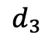
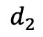
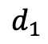
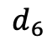
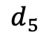
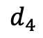
Metapopulation = sub-populations of conspecifics connected by migration or dispersal
individual
population
1
$$d_{1}$$
starfish₁
(x₁)
$$d_{2}$$
metapopulation
2
1
$$d_{6}$$
starfish₂
(x₂)
community
$$d_{5}$$
$$d_{3}$$
3
2
How do the abundances of different subpopulations of the same fish vary in space [and time]?
starfish₃
(x₃)
ecosystem
$$d_{4}$$
3

Slide 44
Community = interacting populations of different species
individual
population
metapopulation
community
ecosystem
Notes:
Then, we look at interactions between species

Slide 45
Community = interacting populations of different species
individual
population
fish
(x)
metapopulation
shark
(y)
community
How does fish abundance vary with changes in shark abundance?
ecosystem

Slide 46


Slide 47
Ecosystem = communities interacting with the abiotic environment
individual
population
metapopulation
community
ecosystem
Notes:
And finally how multiple species interact with each other – and with the environment

Slide 48
Ecosystem = communities interacting with the abiotic environment
individual
population
fish
(x)
metapopulation
(t)
shark
(y)
community
How does fish abundance vary with changes in shark birth rates with temperature?
ecosystem
Notes:
And finally how multiple species interact with each other – and with the environment

Slide 49
Where are we headed?
individual
population
meta-
population
community
ecosystem

Slide 50
Where are we headed?
individual
population
meta-
population
community
ecosystem

Slide 51
Where are we headed?
individual
population
meta-
population
community
ecosystem

Slide 52
Where are we headed?
individual
population
meta-
population
community
ecosystem

Slide 53
Where are we headed?
individual
population
meta-
population
community
ecosystem

Slide 54
Where are we headed?
individual
population
meta-
population
community
ecosystem

Slide 55
Why do we care how populations grow?
Notes:
For conservation aims and predicting reserve size

Slide 56
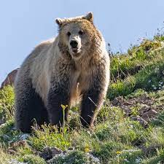
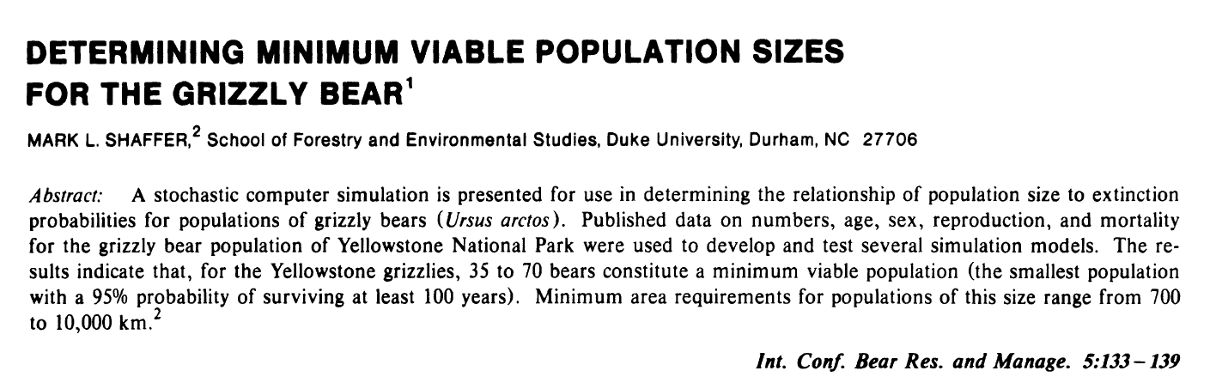
Why do we care how populations grow?
(Shafer 1980)
Notes:
For conservation aims and predicting reserve size

Slide 57
Why do we care how populations grow?
(Shafer 1980)
to protect populations from extinction
Notes:
For conservation aims and predicting reserve size

Slide 58
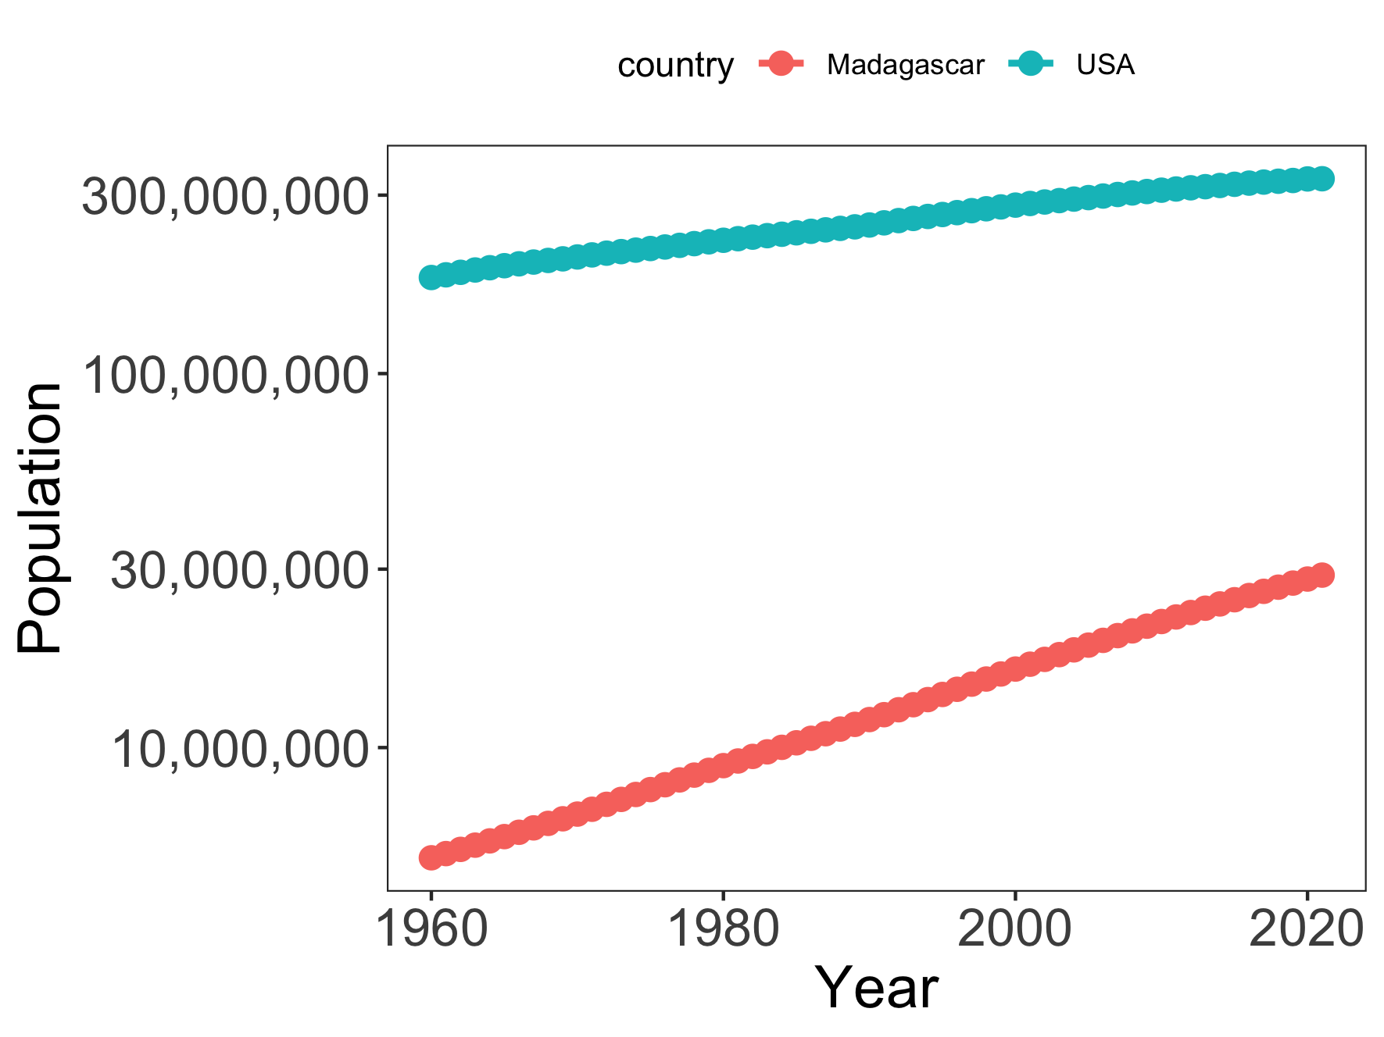
Why do we care how populations grow?
Notes:
For predicting resource use

Slide 59
Why do we care how populations grow?
to forecast resource use
Notes:
For predicting resource use

Slide 60
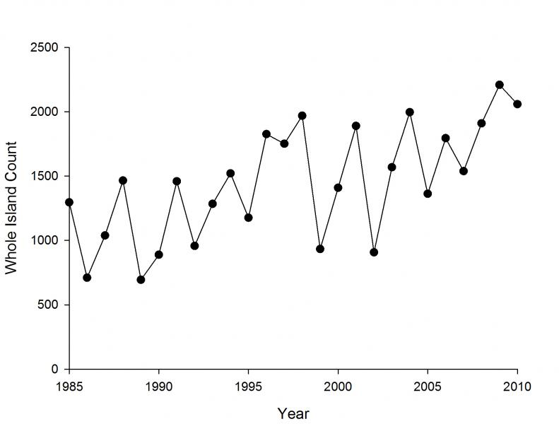
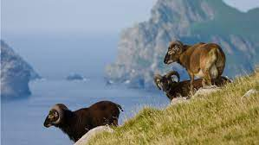
Why do we care how populations grow?
Soay Sheep of St. Kilda, Scotland
Notes:
Since the 1980s, scientists from Cambridge have been censusing them annually and tagging every individual. They exhibit these dramatic population fluctuations

Slide 61
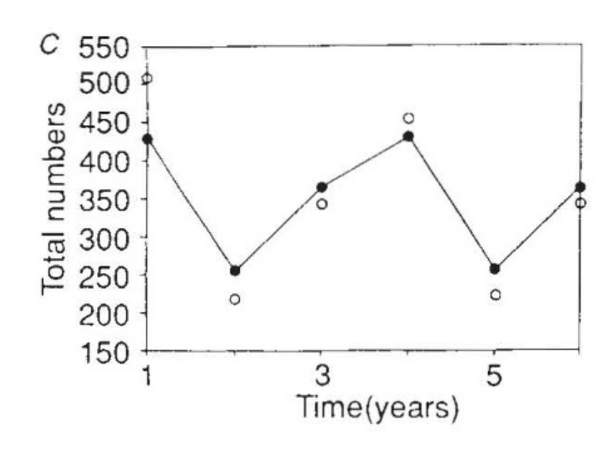
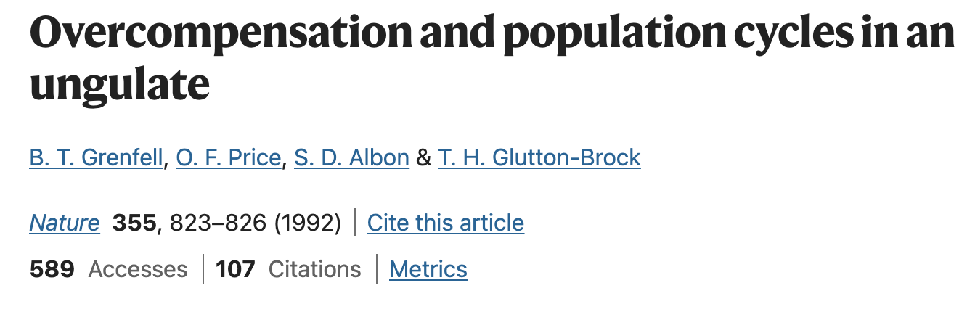
Why do we care how populations grow?
to understand past phenomena
Soay Sheep of St. Kilda, Scotland
Notes:
Models used both to predict and to explain

Slide 62
Model compared against data
Why do we care how populations grow?
to understand past phenomena
Soay Sheep of St. Kilda, Scotland
Notes:
Models used both to predict and to explain

Slide 63
The simplest population model
1. Populations are divided into compartments
2. Individuals within a compartment are homogenously mixed
3. Compartments and transition rates are
determined by biological systems
4. Rates of transferring between compartments
are expressed mathematically
Madagascar
(N)

Slide 64
The simplest population model
1. Populations are divided into compartments
2. Individuals within a compartment are homogenously mixed
3. Compartments and transition rates are
determined by biological systems
4. Rates of transferring between compartments
are expressed mathematically
Madagascar
(N)

Slide 65
The simplest population model
1. Populations are divided into compartments
2. Individuals within a compartment are homogenously mixed
3. Compartments and transition rates are
determined by biological systems
4. Rates of transferring between compartments
are expressed mathematically
Madagascar
(N)
How does the population grow?

Slide 66
The simplest population model
1. Populations are divided into compartments
2. Individuals within a compartment are homogenously mixed
3. Compartments and transition rates are
determined by biological systems
4. Rates of transferring between compartments
are expressed mathematically
births
Madagascar
(N)
How does the population grow?

Slide 67
The simplest population model
1. Populations are divided into compartments
2. Individuals within a compartment are homogenously mixed
3. Compartments and transition rates are
determined by biological systems
4. Rates of transferring between compartments
are expressed mathematically
births
Madagascar
(N)
How does the population decrease?

Slide 68
The simplest population model
1. Populations are divided into compartments
2. Individuals within a compartment are homogenously mixed
3. Compartments and transition rates are
determined by biological systems
4. Rates of transferring between compartments
are expressed mathematically
births
Madagascar
(N)
deaths
How does the population decrease?

Slide 69
The simplest population model
1. Populations are divided into compartments
2. Individuals within a compartment are homogenously mixed
3. Compartments and transition rates are
determined by biological systems
4. Rates of transferring between compartments
are expressed mathematically
births
Madagascar
(N)
deaths
N_{t+1}= N_{t} + births*N_{t}-deaths*N_{t}

Slide 70
The simplest population model
1. Populations are divided into compartments
2. Individuals within a compartment are homogenously mixed
3. Compartments and transition rates are
determined by biological systems
4. Rates of transferring between compartments
are expressed mathematically
births
Madagascar
(N)
deaths
N_{t+1}= N_{t} + births*N_{t}-deaths*N_{t}
N_{t+1}= N_{t} + (births-deaths)*N_{t}

Slide 71
The simplest population model
1. Populations are divided into compartments
2. Individuals within a compartment are homogenously mixed
3. Compartments and transition rates are
determined by biological systems
4. Rates of transferring between compartments
are expressed mathematically
births
Madagascar
(N)
deaths
N_{t+1}= N_{t} + births*N_{t}-deaths*N_{t}
N_{t+1}= N_{t} + (births-deaths)*N_{t}
R=geometric rate of increase R = (births – deaths)
N_{t+1}= N_{t} + R*N_{t}
(pop grows @ R > 0 & declines @ R < 0 )

Slide 72
The simplest population model
1. Populations are divided into compartments
2. Individuals within a compartment are homogenously mixed
3. Compartments and transition rates are
determined by biological systems
4. Rates of transferring between compartments
are expressed mathematically
births
Madagascar
(N)
deaths
N_{t+1}= N_{t} + births*N_{t}-deaths*N_{t}
N_{t+1}= N_{t} + R*N_{t}
λ= population rate of increase
(finite growth rate)
λ=1+R
N_{t+1}= (1+ R)*N_{t}
N_{t+1}=λ*N_{t}
Notes:
Lambda is the growth rate of a discrete population

Slide 73
The simplest population model
1. Populations are divided into compartments
2. Individuals within a compartment are homogenously mixed
3. Compartments and transition rates are
determined by biological systems
4. Rates of transferring between compartments
are expressed mathematically
births
Madagascar
(N)
deaths
N_{t+1}= N_{t} + births*N_{t}-deaths*N_{t}
N_{t+1}= N_{t} + R*N_{t}
λ= population rate of increase
(finite growth rate)
N_{t+1}= (1+ R)*N_{t}
N_{t+1}=λ*N_{t}
(pop grows @ λ >1 & declines @ λ < 1 )

Slide 74
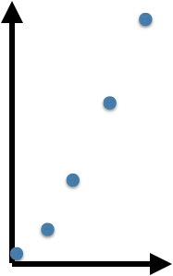
Geometric growth
births
Madagascar
(N)
deaths
Geometric growth is measured in discrete time
λ=N_{t+1}/N_{t}
population size, N_{t}
time
N₁= 𝜆N₀
N₂= 𝜆[𝜆N₀]=𝜆²N₀
N₃= 𝜆³N₀
N_{t}= 𝜆^{t}N₀
λ=population rate of increase

Slide 75
Is discrete time realistic for population growth?

Slide 76
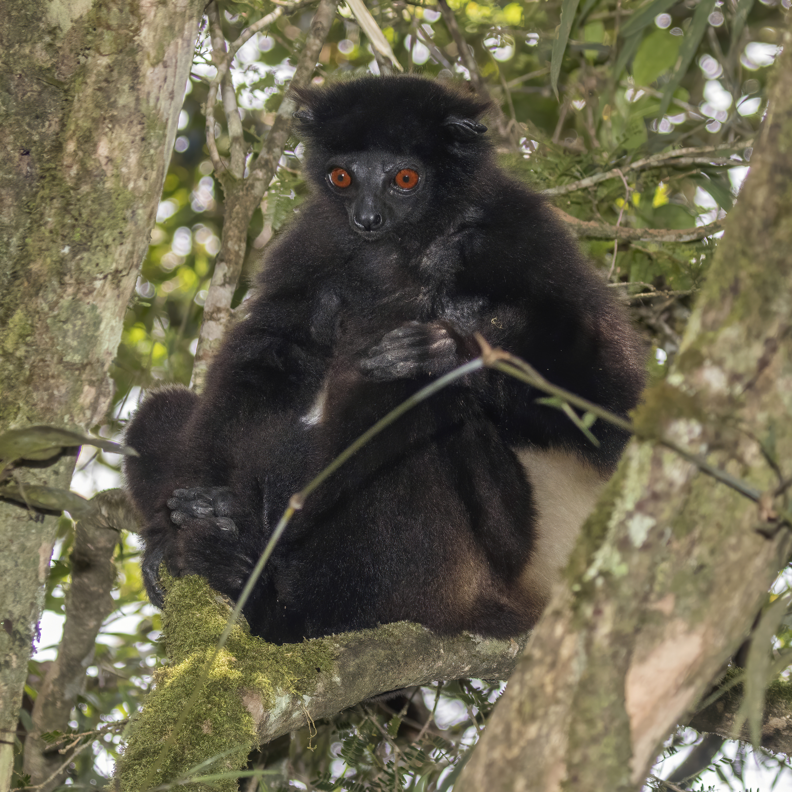
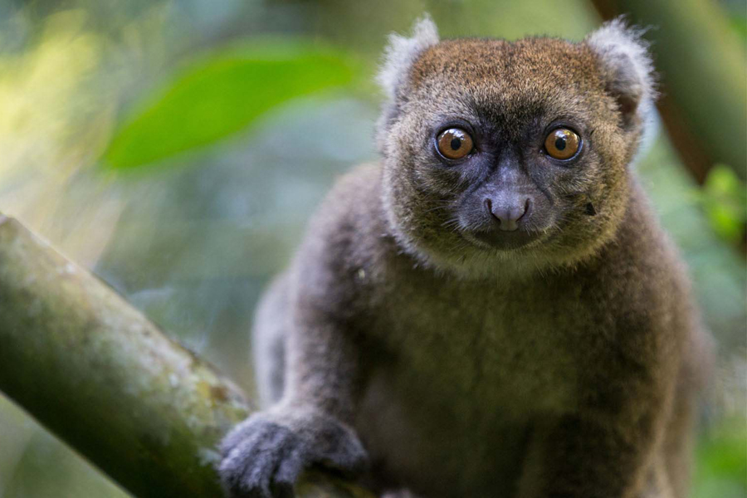
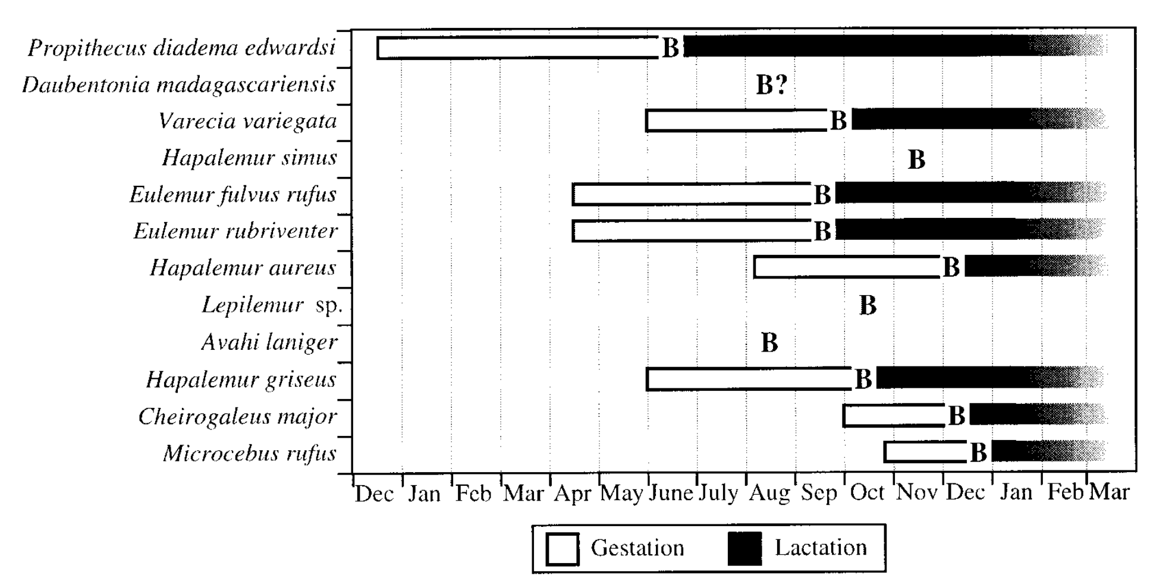
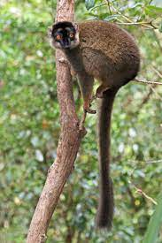
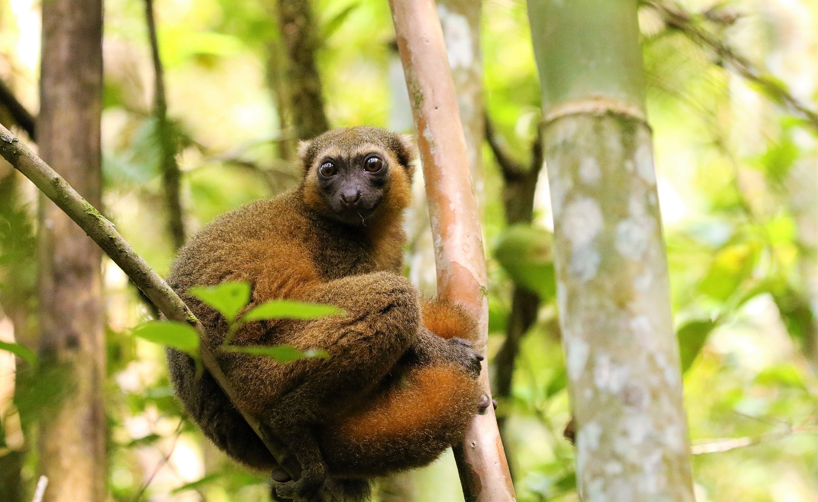
Is discrete time realistic for population growth?
Wright 1999. Am J of Phys Anthr.
Notes:
Lemur breeding by month synchronizes weaning at peak fruit

Slide 77
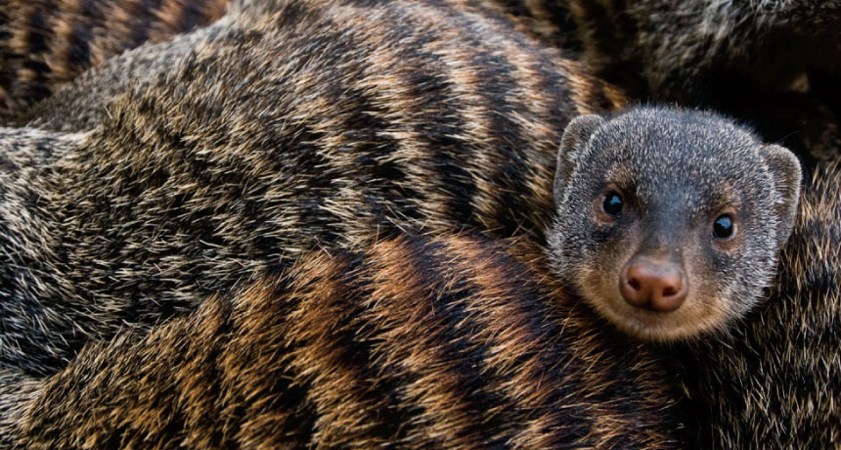
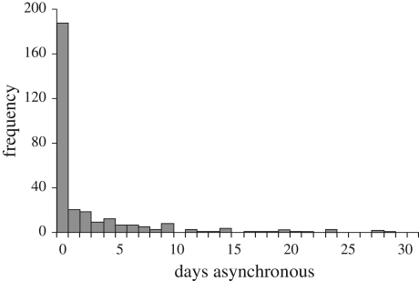
Is discrete time realistic for population growth?
64% of banded mongoose pups are born on the same day.
Hodge et al. 2011. Biology Letters.
Notes:
Infanticide by mother vs. competition with other siblings. Safest to be harder to distinguish parentage apart

Slide 78
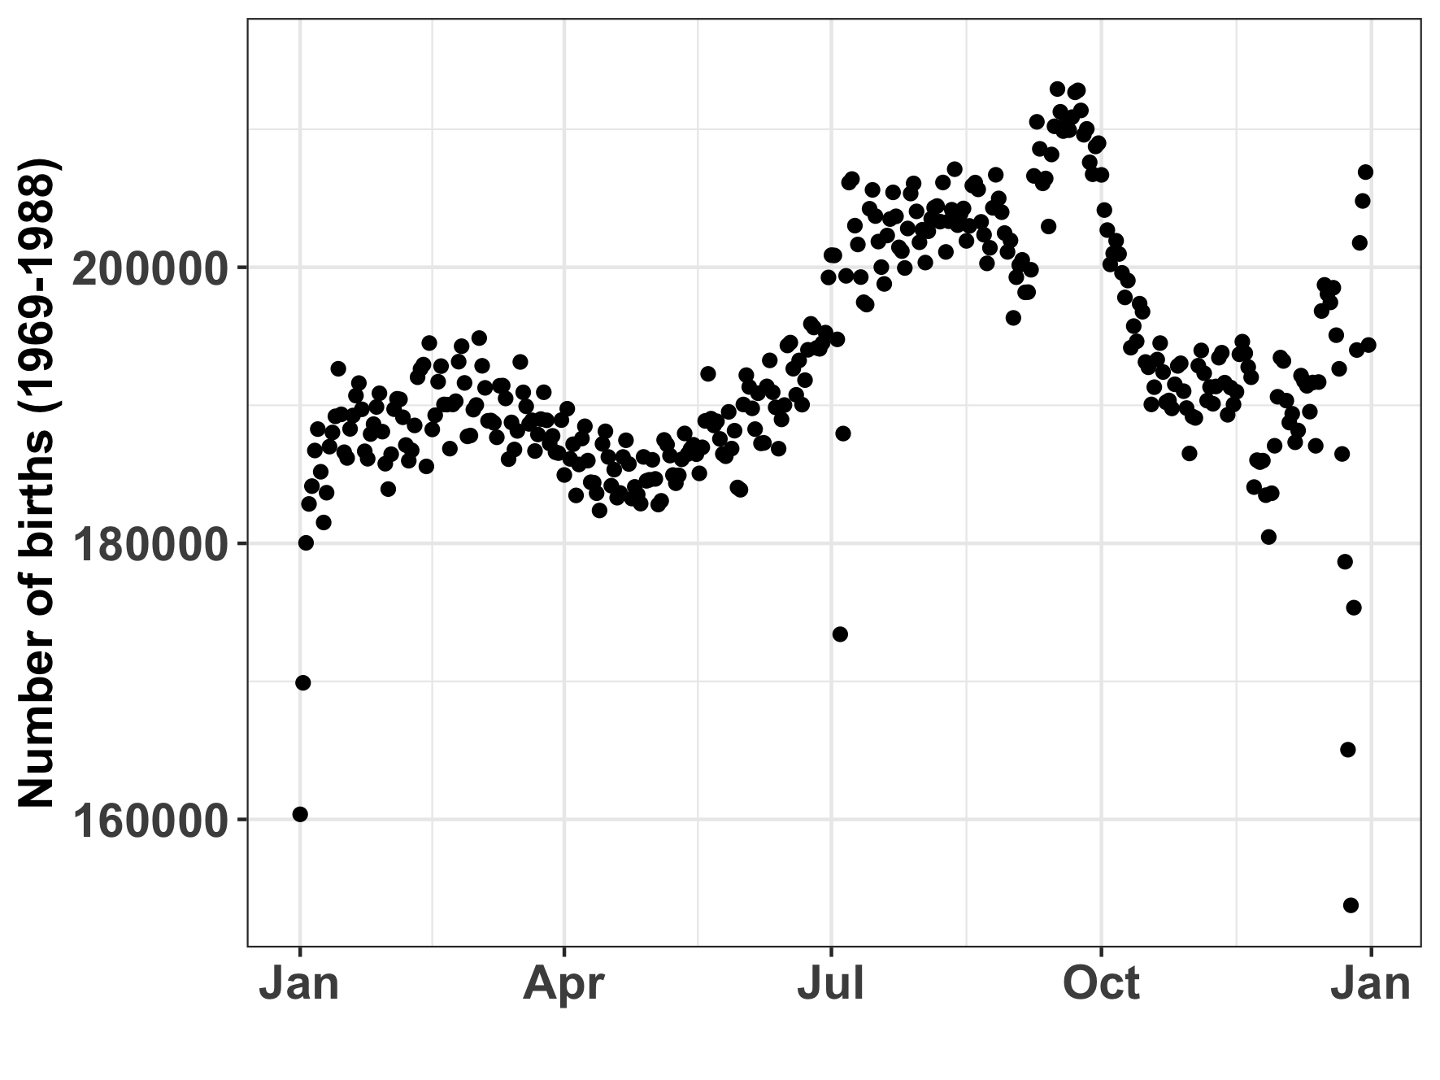
Is discrete time realistic for population growth?
Human births by day in the US
(1969-1988)
Notes:
Infanticide by mother vs. competition with other siblings. Safest to be harder to distinguish parentage apart

Slide 79
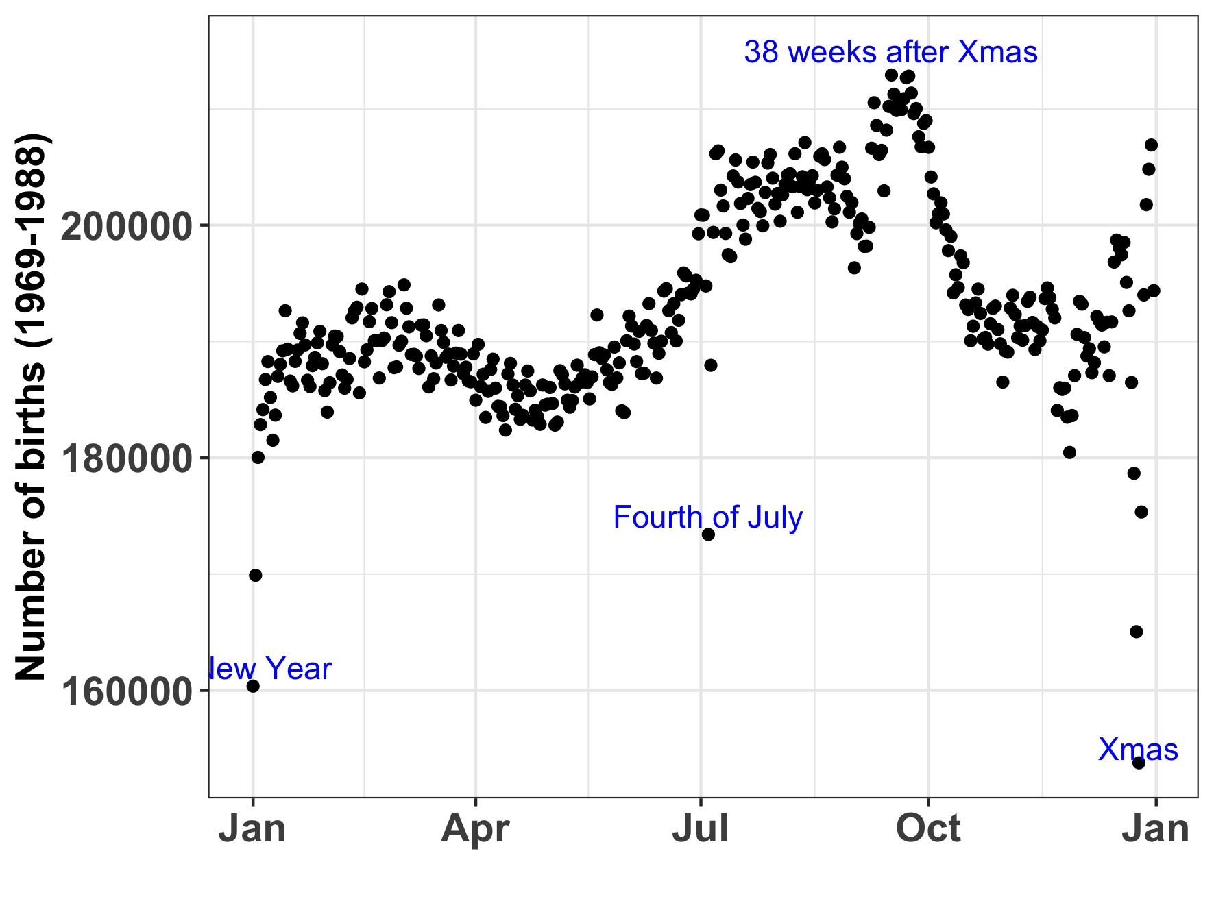
Is discrete time realistic for population growth?
Human births by day in the US
(1969-1988)
Notes:
Infanticide by mother vs. competition with other siblings. Safest to be harder to distinguish parentage apart

Slide 80
Is discrete time realistic for population growth?
Many continuously breeding populations (including human) are better approximated by an assumption of a continuous birth rate
Univoltine/bivoltine species may be better approximated by discrete time growth rates
Voltinism = number of broods (generations) produced per year
Ultimately the best choice model depends on the available data!
For example, discrete time model may work well for human populations if censuses are conducted only annually

Slide 81
Is discrete time realistic for population growth?
Many continuously breeding populations (including human) are better approximated by an assumption of a continuous birth rate
Univoltine/bivoltine species may be better approximated by discrete time growth rates
Voltinism = number of broods (generations) produced per year
Ultimately the best choice model depends on the available data!
For example, discrete time model may work well for human populations if censuses are conducted only annually

Slide 82
Is discrete time realistic for population growth?
Many continuously breeding populations (including human) are better approximated by an assumption of a continuous birth rate
Univoltine/bivoltine species may be better approximated by discrete time growth rates
Voltinism = number of broods (generations) produced per year
Ultimately the best choice model depends on the available data!
For example, discrete time model may work well for human populations if censuses are conducted only annually

Slide 83
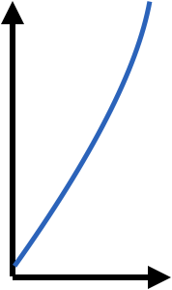
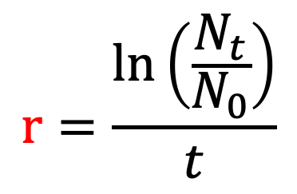
Geometric vs. exponential growth
births
Madagascar
(N)
deaths
Geometric growth
Exponential growth is measured in continuous time
$$r=\frac{\ln\left(\frac{N_{t}}{N_{0}}\right)}{t}$$
λ=N_{t+1}/N_{t}
population size, N_{t}
population size, N_{t}
time
time
N₁= 𝜆N₀
N₂= 𝜆[𝜆N₀]=𝜆²N₀
N₃= 𝜆³N₀
N_{t}= 𝜆^{t}N₀
dN(t)/dt= rN(t)
λ=population rate of increase
r=intrinsic (instantaneous) rate of increase

Slide 84
Geometric vs. exponential growth
births
Madagascar
(N)
deaths
Discrete time
Continuous time
Continuous time
dN(t)/dt = rN(t)
Separation of variables:
dN(t)/N(t) = r dt
Integrate both sides:
∫ dN(t)/N(t) = ∫ r dt
By definition:
log(N(t)) = rt + c
Take exponentials:
N(t) = e^{rt + c} = Ce^{rt}
N(t) = N(0)e^{rt}
λ=N_{t+1}/N_{t}
population size, N_{t}
time
N₁= 𝜆N₀
N₂= 𝜆[𝜆N₀]=𝜆²N₀
N₃= 𝜆³N₀
N_{t}= 𝜆^{t}N₀

Slide 85
Geometric vs. exponential growth
births
Madagascar
(N)
deaths
Discrete time
Continuous time
Continuous time
dN(t)/dt = rN(t)
Separation of variables:
dN(t)/N(t) = r dt
Integrate both sides:
∫ dN(t)/N(t) = ∫ r dt
By definition:
log(N(t)) = rt + c
Take exponentials:
N(t) = e^{rt + c} = Ce^{rt}
N(t) = N(0)e^{rt}
λ=N_{t+1}/N_{t}
population size, N_{t}
time
N₁= 𝜆N₀
N₂= 𝜆[𝜆N₀]=𝜆²N₀
N₃= 𝜆³N₀
N_{t}= 𝜆^{t}N₀

Slide 86
Geometric vs. exponential growth
births
Madagascar
(N)
deaths
Discrete time
Continuous time
Continuous time
dN(t)/dt = rN(t)
Separation of variables:
dN(t)/N(t) = r dt
Integrate both sides:
∫ dN(t)/N(t) = ∫ r dt
By definition:
log(N(t)) = rt + c
Take exponentials:
N(t) = e^{rt + c} = Ce^{rt}
N(t) = N(0)e^{rt}
λ=N_{t+1}/N_{t}
population size, N_{t}
time
N₁= 𝜆N₀
N₂= 𝜆[𝜆N₀]=𝜆²N₀
N₃= 𝜆³N₀
N_{t}= 𝜆^{t}N₀

Slide 87
Geometric vs. exponential growth
births
Madagascar
(N)
deaths
Discrete time
Continuous time
Continuous time
dN(t)/dt = rN(t)
Separation of variables:
dN(t)/N(t) = r dt
Integrate both sides:
∫ dN(t)/N(t) = ∫ r dt
By definition:
ln(N(t)) = rt + c
Take exponentials:
N(t) = e^{rt + c} = Ce^{rt}
N(t) = N(0)e^{rt}
λ=N_{t+1}/N_{t}
population size, N_{t}
time
N₁= 𝜆N₀
N₂= 𝜆[𝜆N₀]=𝜆²N₀
N₃= 𝜆³N₀
N_{t}= 𝜆^{t}N₀

Slide 88
Geometric vs. exponential growth
births
Madagascar
(N)
deaths
Discrete time
Continuous time
Continuous time
dN(t)/dt = rN(t)
Separation of variables:
dN(t)/N(t) = r dt
Integrate both sides:
∫ dN(t)/N(t) = ∫ r dt
By definition:
ln(N(t)) = rt + c
Take exponentials:
N(t) = e^{rt + c} = Ce^{rt}
N(t) = N(0)e^{rt}
λ=N_{t+1}/N_{t}
population size, N_{t}
time
N₁= 𝜆N₀
N₂= 𝜆[𝜆N₀]=𝜆²N₀
N₃= 𝜆³N₀
N_{t}= 𝜆^{t}N₀

Slide 89
Geometric vs. exponential growth
births
Madagascar
(N)
deaths
Discrete time
Continuous time
$$r=\frac{\ln\left(\frac{N_{t}}{N_{0}}\right)}{t}$$
λ=N_{t+1}/N_{t}
population size, N_{t}
population size, N_{t}
time
time
N₁= 𝜆N₀
N₂= 𝜆[𝜆N₀]=𝜆²N₀
N₃= 𝜆³N₀
N_{t}= 𝜆^{t}N₀
N_{t} = N₀e^{rt}
λ=population rate of increase
r=intrinsic (instantaneous) rate of increase
(pop grows @ λ >1 & declines @ λ < 1 )
(pop grows @ r > 0 & declines @ r < 0 )

Slide 90
Geometric vs. exponential growth
geometric
N_{t}= 𝜆^{t}N₀
exponential
N_{t} = N₀e^{rt}
Discrete time
Continuous time
population size, N_{t}
population size, N_{t}

Slide 91
Geometric vs. exponential growth
geometric
N_{t}= 𝜆^{t}N₀
exponential
N_{t} = N₀e^{rt}
𝜆^{t}N₀ = N₀e^{rt}
Discrete time
Continuous time
population size, N_{t}
population size, N_{t}
time
time

Slide 92
Geometric vs. exponential growth
geometric
N_{t}= 𝜆^{t}N₀
exponential
N_{t} = N₀e^{rt}
𝜆^{t}N₀ = N₀e^{rt}
𝜆^{t} = e^{rt}
Discrete time
Continuous time
population size, N_{t}
population size, N_{t}
time
time

Slide 93
Geometric vs. exponential growth
geometric
N_{t}= 𝜆^{t}N₀
exponential
N_{t} = N₀e^{rt}
𝜆^{t}N₀ = N₀e^{rt}
𝜆^{t} = e^{rt}
𝜆 = e^{r}
Discrete time
Continuous time
population size, N_{t}
population size, N_{t}
time
time

Slide 94
Geometric vs. exponential growth
geometric
N_{t}= 𝜆^{t}N₀
exponential
N_{t} = N₀e^{rt}
Continuous models can be discretized.
Discrete models can be approximated in continuous time.
How to choose what to do?
The answer depends on the data and the question at hand!
𝜆^{t}N₀ = N₀e^{rt}
𝜆^{t} = e^{rt}
𝜆 = e^{r}
Discrete time
Continuous time
population size, N_{t}
population size, N_{t}
time
time

Slide 95
Geometric vs. exponential growth
geometric
N_{t}= 𝜆^{t}N₀
exponential
N_{t} = N₀e^{rt}
Continuous models can be discretized.
Discrete models can be approximated in continuous time.
How to choose what to do?
The answer depends on the data and the question at hand!
𝜆^{t}N₀ = N₀e^{rt}
𝜆^{t} = e^{rt}
𝜆 = e^{r}
Discrete time
Continuous time
population size, N_{t}
population size, N_{t}
time
time

Slide 96
Geometric vs. exponential growth
geometric
N_{t}= 𝜆^{t}N₀
exponential
N_{t} = N₀e^{rt}
Continuous models can be discretized.
Discrete models can be approximated in continuous time.
How to choose what to do?
The answer depends on the data and the question at hand!
𝜆^{t}N₀ = N₀e^{rt}
𝜆^{t} = e^{rt}
𝜆 = e^{r}
Discrete time
Continuous time
population size, N_{t}
population size, N_{t}
time
time

Slide 97
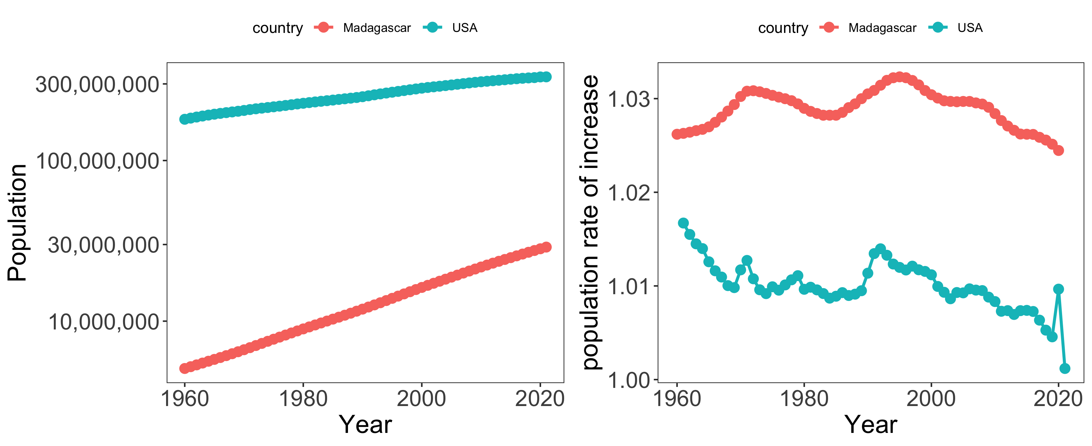
Geometric vs. exponential growth
Notes:
Remember our two countries

Slide 98
Geometric vs. exponential growth
λ=N_{t+1}/N_{t}
_{where t = 1 year}
Which country has the higher growth rate?
Notes:
Remember our two countries

Slide 99
Geometric vs. exponential growth
λ=N_{t+1}/N_{t}
Notes:
Population rate of increase per year – look at COVID in the US!

Slide 100
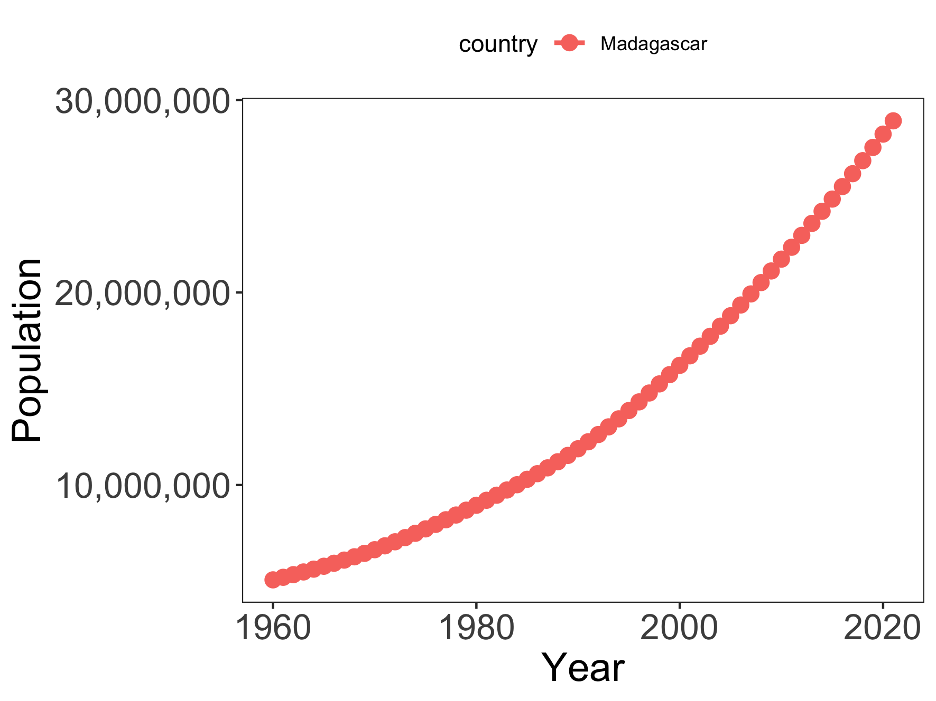
Geometric growth approximation of Madagascar’s population
λ=N_{t+1}/N_{t}
mean λ = 1.02
Notes:
They will diverge more quickly as the “timestep” gets larger

Slide 101
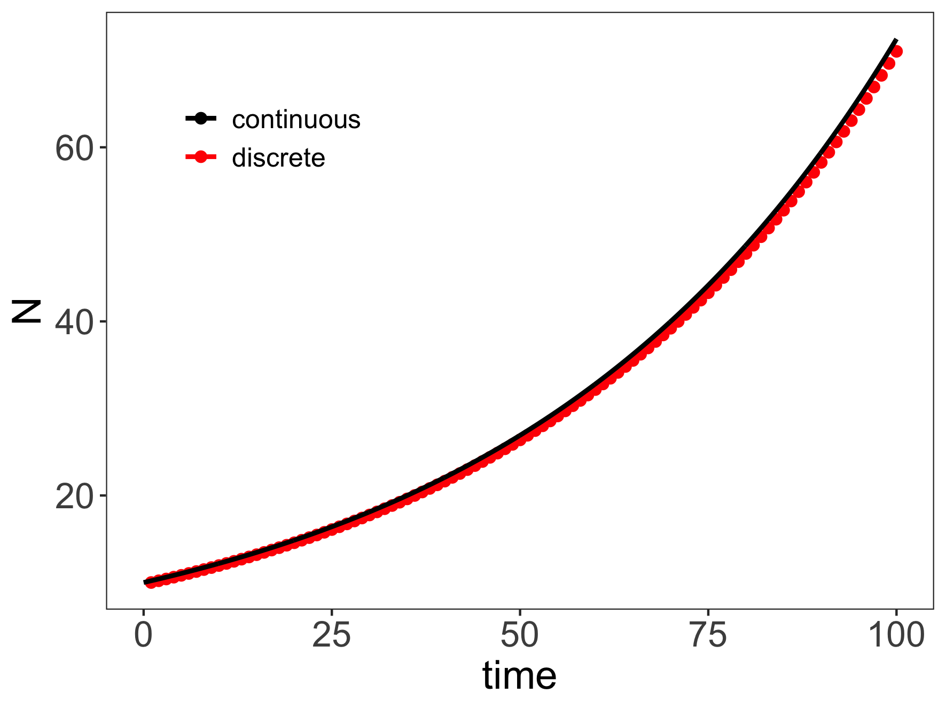
Projecting population under geometric vs. exponential growth
Geometric: λ = 1.02
Exponential: r = ln(1.02) = 0.02
Models are similar over short time horizons and/or when discrete timesteps are small!

Slide 102
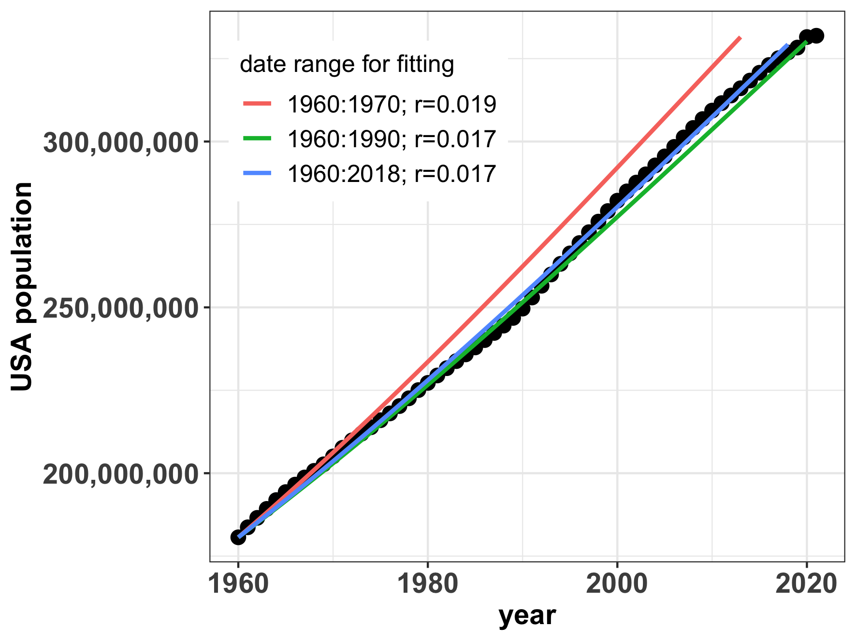
We can estimate growth rates by ‘fitting’ a model to data
models (by date range for fitting)
data
Notes:
Fits to data from earlier years only overestimate current population growth rates

Slide 103
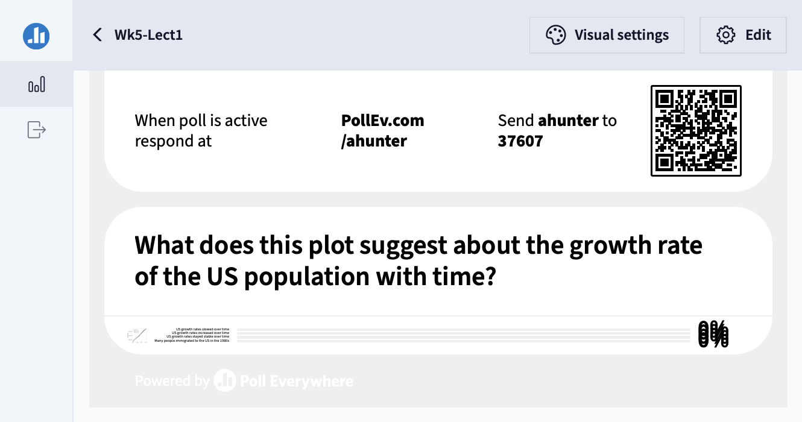

Slide 104
We can estimate growth rates by ‘fitting’ a model to data
US growth rates slowed over the time period!
Model fits to data from earlier years overestimate current population growth rates
Notes:
Fits to data from earlier years only overestimate current population growth rates

Slide 105

We can estimate growth rates by ‘fitting’ a model to data

Slide 106
We can estimate growth rates by ‘fitting’ a model to data
Madagascar growth rates accelerated over the time period!
Model fits to data from earlier years underestimate current population growth rates
Notes:
Fits to data from earlier years only underestimate current population trends

Slide 107
Both geometric and exponential growth are unchecked.

Slide 108

Malthus proposed some limits to population growth
“[. . . ] the power of population is indefinitely greater than the power in the earth to produce subsistence for man. Population, when unchecked, increases in a geometrical ratio. Subsistence increases only in an arithmetical ratio. A slight acquaintance with numbers will shew the immensity of the first power in comparison of the second. By that law of our nature which makes food necessary to the life of man, the effects of these two unequal powers must be kept equal. This implies a strong and constantly operating check on population from the difficulty of subsistence. This difficulty must fall somewhere; and must necessarily be severely felt by a large portion of mankind.”
- Thomas Malthus (1798)
An Essay on the Principle of Population as it Effects the Future Improvement of Society,
With Remarks on the Speculations of Mr Godwin, Mr. Condorcet and Other Writers
Notes:
Thomas Malthus. English cleric in the late 1700s, early 1800s.
Published the book anonymously.

Slide 109

Malthus proposed some limits to population growth
- Thomas Malthus (1798)
An Essay on the Principle of Population as it Effects the Future Improvement of Society,
With Remarks on the Speculations of Mr. Godwin, Mr. Condorcet and Other Writers
Notes:
Thomas Malthus. English cleric in the late 1700s, early 1800s.
Inspired strong reactions. Darwin was inspired. Marx was disgusted
Marx claimed that poverty and hunger was a result of the capitalist economy, not population growth. He argued that food supplies would keep pace with population growth if wealth was distributed fairly
Malthus offered no basis for his arithmetical ratio for food, and there were occasions in which food had increased geometrically to match a geometric rise in population (as in North America)
Indeed, the industrial revolution proved that human food production could keep pace with population growth

Slide 110
Malthus proposed some limits to population growth
Problem!
No basis for assumption of arithmetical ratio for food.
- Thomas Malthus (1798)
An Essay on the Principle of Population as it Effects the Future Improvement of Society,
With Remarks on the Speculations of Mr. Godwin, Mr. Condorcet and Other Writers
Notes:
Thomas Malthus. English cleric in the late 1700s, early 1800s.
Inspired strong reactions. Darwin was inspired. Marx was disgusted
Marx claimed that poverty and hunger was a result of the capitalist economy, not population growth. He argued that food supplies would keep pace with population growth if wealth was distributed fairly
Malthus offered no basis for his arithmetical ratio for food, and there were occasions in which food had increased geometrically to match a geometric rise in population (as in North America)
Indeed, the industrial revolution proved that human food production could keep pace with population growth
Led him to write a second essay that proposed all kinds of ways to keep population in check: famine, war, abortion, delayed marriage. Very anti-charity
An Essay on the Principle of Population, or a View of its Past and Present Effects
on Human Happiness, With an Enquiry Into Our Prospects Respecting the Future Removal or Mitigation of the Evils Which It Occasions

Slide 111

Logistic growth equation
“We shall not insist on the hypothesis of geometric progression, given that it can hold only in very special
circumstances; for example, when a fertile territory of almost unlimited size happens to be inhabited by people…”
- Pierre-Francois Verhulst (1838)
$$\frac{dN}{dt}=rN\left(1−\frac{N}{K}\right)$$
Notes:
Verlhust = Belgian mathematician in the 1800s

Slide 112
Logistic growth equation
“We shall not insist on the hypothesis of geometric progression, given that it can hold only in very special
circumstances; for example, when a fertile territory of almost unlimited size happens to be inhabited by people…”
- Pierre-Francois Verhulst (1838)
change in population abundance per unit time
$$\frac{dN}{dt}=rN\left(1−\frac{N}{K}\right)$$
population size
intrinsic growth rate
carrying capacity

Slide 113
Logistic growth equation
“We shall not insist on the hypothesis of geometric progression, given that it can hold only in very special
circumstances; for example, when a fertile territory of almost unlimited size happens to be inhabited by people…”
- Pierre-Francois Verhulst (1838)
change in population abundance per unit time
$$\frac{dN}{dt}=rN\left(1−\frac{N}{K}\right)$$
population size
intrinsic growth rate
carrying capacity
Population growth slows as abundance (N) approaches carrying capacity (K).
Population growth is density-dependent.

Slide 114


Logistic growth equation
$$\frac{dN}{dt}=rN\left(1−\frac{N}{K}\right)$$
Population growth slows to 0 as N approaches K, or – in other words – as the total population size approaches carrying capacity.
N(t)
Notes:
Ecology – interaction of organisms with each other (population) and their environment (sets K)
R vs. K selected species

Slide 115
Logistic growth equation
$$\frac{dN}{dt}=rN\left(1−\frac{N}{K}\right)$$
Carrying capacity=
maximum population size an environment can sustain indefinitely.
N(t)
Notes:
Ecology – interaction of organisms with each other (population) and their environment (sets K)
Food, shelter, water
Can CHANGE!

Slide 116
Logistic growth equation
$$\frac{dN}{dt}=rN\left(1−\frac{N}{K}\right)$$
Carrying capacity=
maximum population size an environment can sustain indefinitely.
Ecology = organisms interacting with each other and the environment
N(t)
Notes:
Ecology – interaction of organisms with each other (population) and their environment (sets K)
Food, shelter, water
Can CHANGE!

Slide 117
Logistic growth equation
$$\frac{dN}{dt}=rN\left(1−\frac{N}{K}\right)$$
Carrying capacity=
maximum population size an environment can sustain indefinitely.
Ecology = organisms interacting with each other and the environment
K can change!
N(t)
Notes:
Ecology – interaction of organisms with each other (population) and their environment (sets K)
Food, shelter, water
Can CHANGE!

Slide 118
Logistic growth equation
$$\frac{dN}{dt}=rN\left(1−\frac{N}{K}\right)$$
Carrying capacity=
maximum population size an environment can sustain indefinitely.
Ecology = organisms interacting with each other and the environment
K can change!
‘r’ vs. ‘K’-selected species
N(t)
Notes:
Ecology – interaction of organisms with each other (population) and their environment (sets K)
Food, shelter, water
Can CHANGE!

Slide 119


Logistic growth and equilibrium
$$\frac{dN}{dt}=rN\left(1−\frac{N}{K}\right)$$
$$\frac{dN}{dt}=0$$
When population size is not changing, the population is said to be at equilibrium.
N(t)

Slide 120


Logistic growth and equilibrium
$$\frac{dN}{dt}=rN\left(1−\frac{N}{K}\right)$$
$$\frac{dN}{dt}=0$$
$$0=rN\left(1−\frac{N}{K}\right)$$
N(t)
$$N=K$$
A little algebra shows that the population at carrying capacity is at equilibrium.

Slide 121



Logistic growth and equilibrium
$$\frac{dN}{dt}=rN\left(1−\frac{N}{K}\right)$$
$$\frac{dN}{dt}=0$$
$$0=rN\left(1−\frac{N}{K}\right)$$
$$N=K or$$
logistic growth equilibria
$$N=0$$

Slide 122
Logistic growth and equilibrium
$$\frac{dN}{dt}=rN\left(1−\frac{N}{K}\right)$$
$$\frac{dN}{dt}=0$$
$$0=rN\left(1−\frac{N}{K}\right)$$
$$N=K or$$
logistic growth equilibria
$$N=0$$
What is K?

Slide 123

Logistic growth and equilibrium
$$\frac{dN}{dt}=rN\left(1−\frac{N}{K}\right)$$
$$\frac{dN}{dt}=0$$
$$K=5$$
$$0=rN\left(1−\frac{N}{K}\right)$$
$$N=K or$$
logistic growth equilibria
$$N=0$$
What is K?

Slide 124

Logistic growth and equilibrium
$$\frac{dN}{dt}=rN\left(1−\frac{N}{K}\right)$$
$$\frac{dN}{dt}=0$$
$$K=5$$
$$0=rN\left(1−\frac{N}{K}\right)$$
$$N=K or$$
logistic growth equilibria
$$N=0$$
Stability: If the population is perturbed, will it return to equilibrium?

Slide 125
Many populations will fluctuate above or below carrying capacity.
Soay Sheep of St. Kilda, Scotland

Slide 126
Many populations will fluctuate above or below carrying capacity.
But they can still be stable populations if they return to equilibrium.
Soay Sheep of St. Kilda, Scotland
Notes:
We’ll talk about what happens when you

Slide 127
Many populations will fluctuate above or below carrying capacity.
But they can still be stable populations if they return to equilibrium.
Soay Sheep of St. Kilda, Scotland
In some cases, it is not possible to recover.

Slide 128


Many populations will fluctuate above or below carrying capacity.
But they can still be stable populations if they return to equilibrium.
In some cases, it is not possible to recover.
Notes:
Orange roughy = overexploited fishery in mostly southern hemisphere. Large, very long-lived fish. Biggest fishery in NZ but also important in Australia

Slide 129


Logistic growth still does not describe human populations well.
K=302,000,000
K=28,000,000
Notes:
We are exceeding carrying capacity as might have been projected in 1990… Maybe the US is starting to move towards an S curve but Madagascar definitely not
The question is whether we overshoot our own K, as Malthus predicted - or not!

